Slide 1
Youth Programs
EDSI Solutions

Slide 2
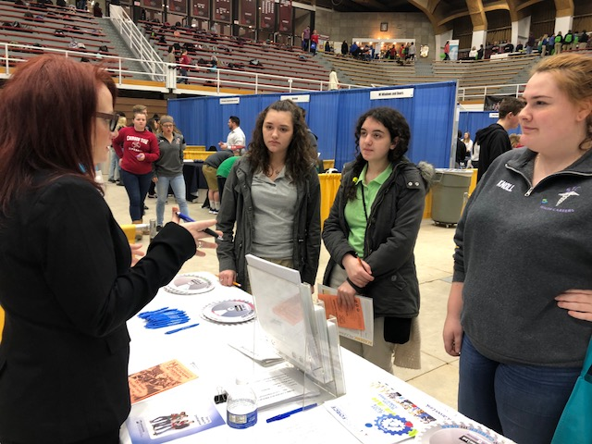
EDSI Solutions Youth Programs at PA Careerlink
Youth Programs Manager
Laura Hoppes
Contact: 570-622-5253 ext: 146
TANF Youth Program – In School Youth
Ages up to 18
Career Navigators: Liz Brensinger
Contact: 570-622-5253 ext: 120
WIOA Youth Program – Out of School Youth
Ages 16 to 24
Career Navigator: Tommie McShaw
Contact 570-622-5253 ext: 147

Slide 3
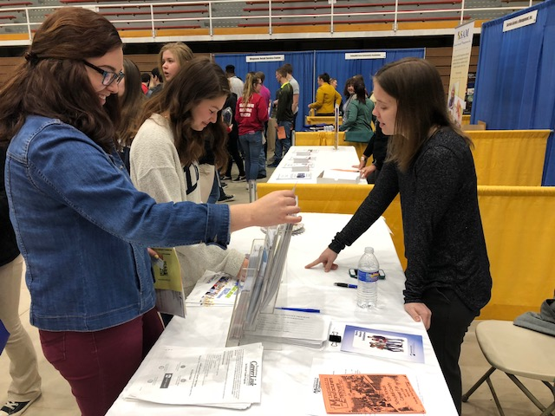
Who the Youth Team Can Help…
Student eligibility
Residents of Schuylkill County
TANF YOUTH: Junior or Senior in High School
WIOA YOUTH: Out of School - Ages 16 to 24
Family or individual on cash assistance or food stamps
Foster care, Homeless, Runaway, Migrant Youth, Court Involvement, Youth of Incarcerated Parents or Youth with Disability
Pregnant or Parenting Youth

Slide 4
What we provide to enrollees…
High School Equivalency Program
Paid Work Experience
Information on Pre-apprenticeship and Apprenticeship Programs
Internships and Job Shadowing
On-The-Job Training
Financial Literacy
Career Awareness/Exploration
Stem Awareness/Exploration
Entrepreneurial Activities
Soft Skills Development
Adult Mentoring
Leadership and Team Building Development
Activities that help youth prepare for and transition to post-secondary education and training

Slide 5
High School Equivalency Program
If you don’t have a high school diploma, you can earn a high school equivalency (HSE)
Having your HSE can open a lot of doors. People who have a diploma or equivalency earn more than people who don't. Also, many jobs and training programs require that you a diploma or its equivalent.
A high school equivalency or HSE is a recognized alternative to a high school diploma. There are two common exams used to determine high school equivalency:
The General Educational Development (GED®) test
The High School Equivalency Test (HiSET)

Slide 6
Employment Readiness Workshops
Résumé Writing
Interview Skills
Navigating Our Website
Budgeting
TANF & WIOA Youth can take advantage of various
PA CareerLink Workshops
They can access a calendar of events and self-register on www.pacareerlink.pa.gov.

Slide 7
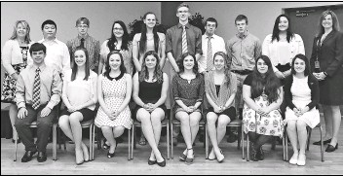
Y.E.S. PROGRAM
The Youth Program utilizes Y.E.S. Northeast as a component of their leadership development skills programming.
The Y.E.S. (Your Employability Skills) Northeast Certificate Program, which is administered by the Northeast PA Manufacturers & Employers Council. The program is designed to bridge the worlds of education and work by developing and enhancing students’ basic job skills that managers in all businesses and industries require.
Y.E.S Schuylkill Graduates

Slide 8
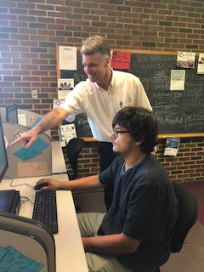
ESDI & PA Careerlink Job Fairs
Through our connection with PA CareerLink we have multiple outlets to help connect our youth to further their work experience.
On Site: (Pictured left) Youth can utilize our Computer Resource Center (CRC) to research current available job opportunities with the assistance of our CRC Coordinator.
EDSI and PA CareerLink sponsor local job fairs at the Fairlane Village Mall twice a year where job seekers can meet multiple employers, vendors, and service providers directly.

Slide 9
The TANF Youth Team meets with eligible & enrolled students once a month during a club or activity period. We discuss their successes, their struggles, and provide activities to encourage the development of soft skills. Pictured below Minersville High School students and their Dot Tower.

Slide 10
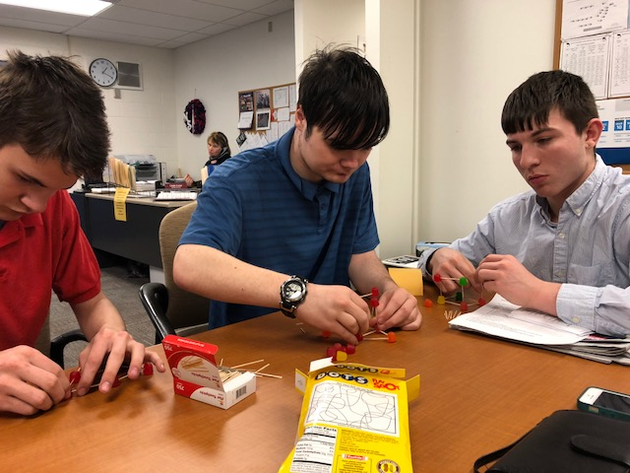
SOFT SKILLS DEVELOPMENT Tamaqua & North Schuylkill High School students work on projects that build communication and teamwork skills

Slide 11
CAREER EXPLORATIONS WORKSHOPS & STEM AWARENESS

Slide 12
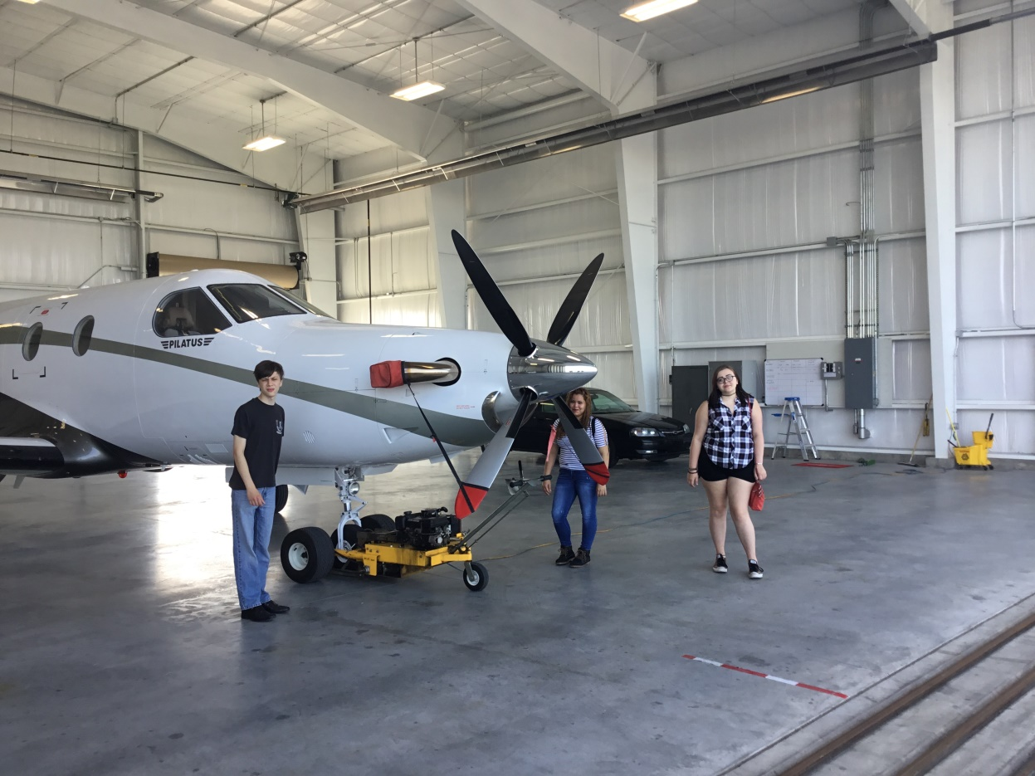
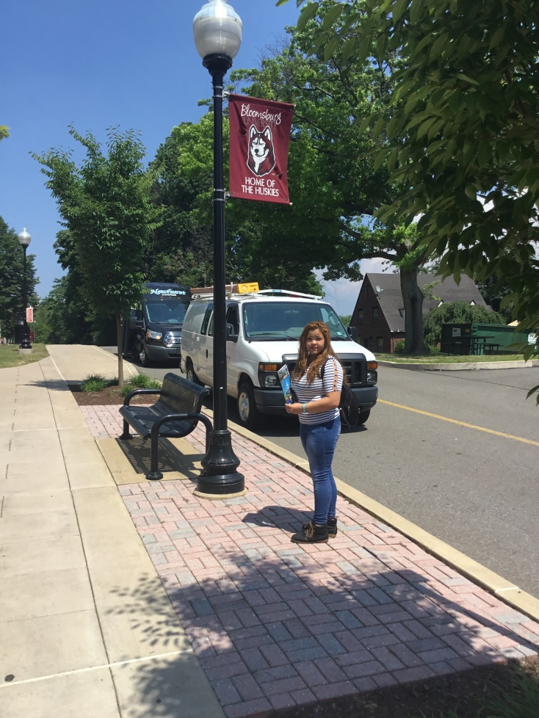
SCHOOL VISITS and CAREER EXPLORATION FIELD TRIPS Pictured above: Left: A college visit to Bloomsburg University Right: A visit to the Schuylkill County Joe Zerbey Airport

Slide 13
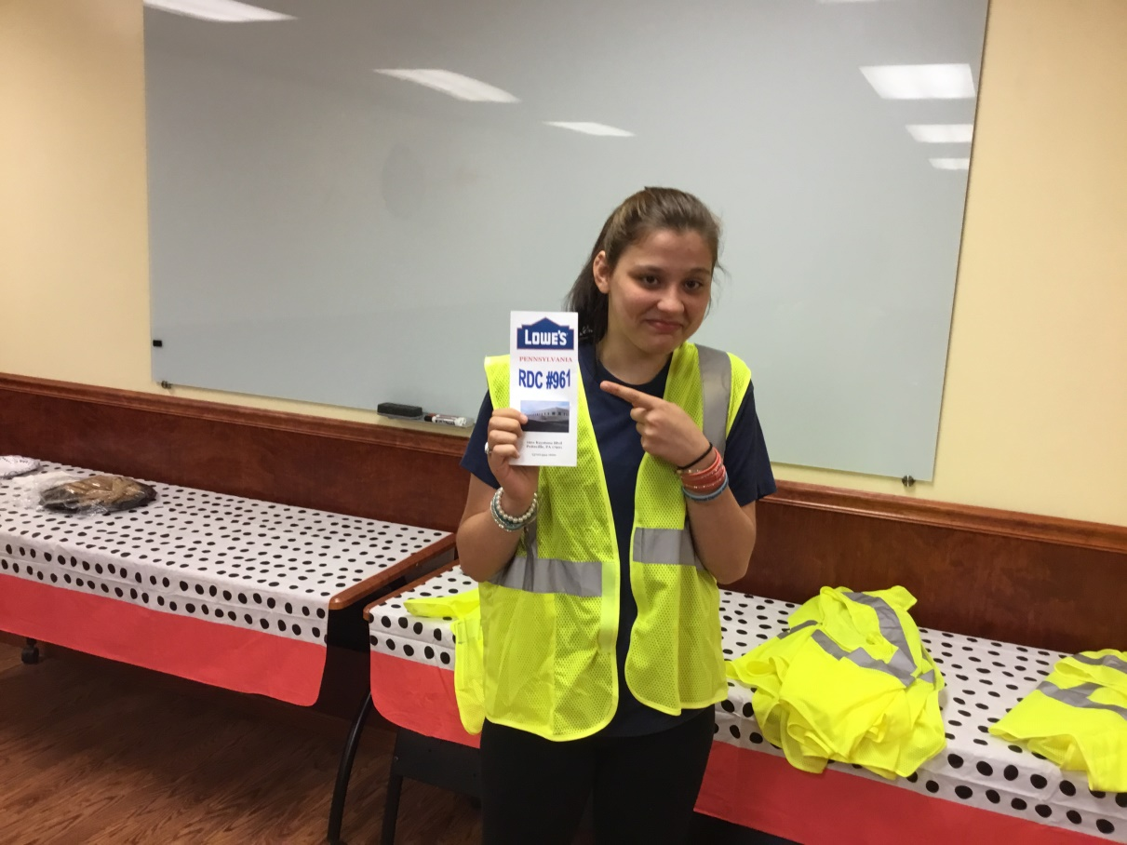
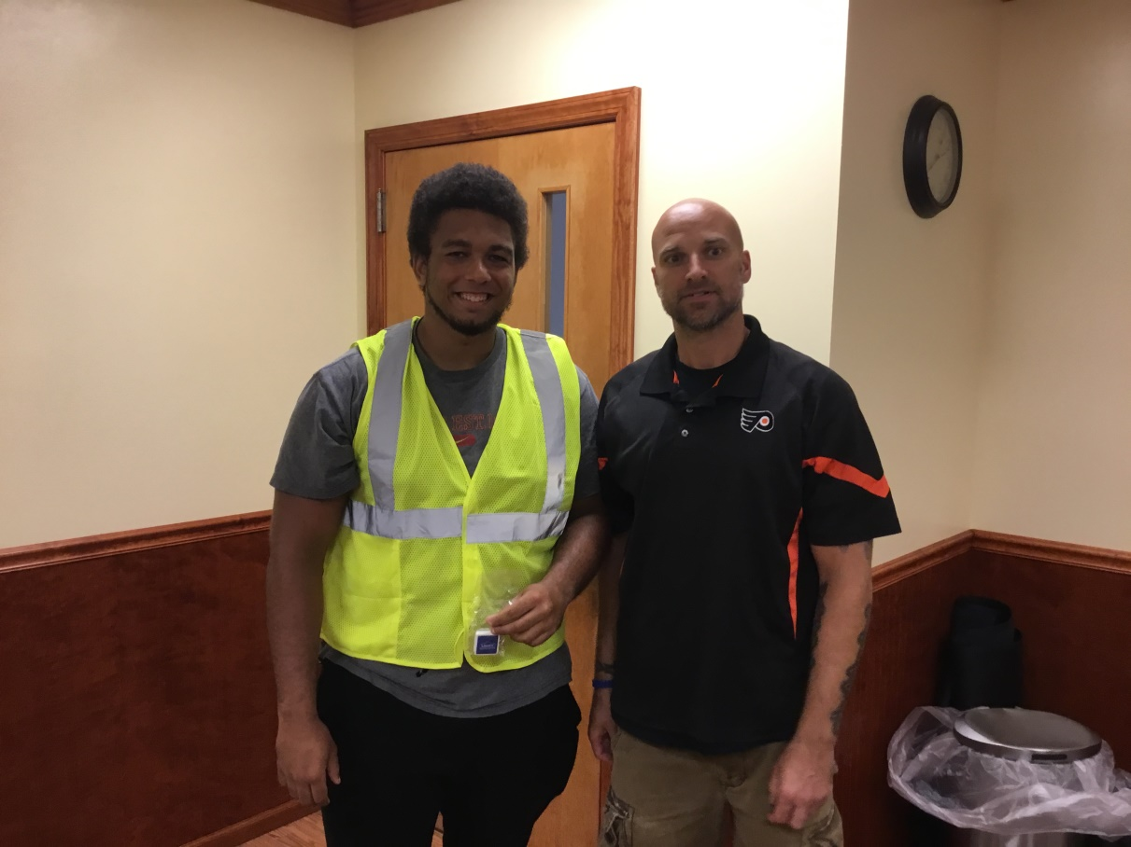
Career Exploration Field Trips!

Slide 14
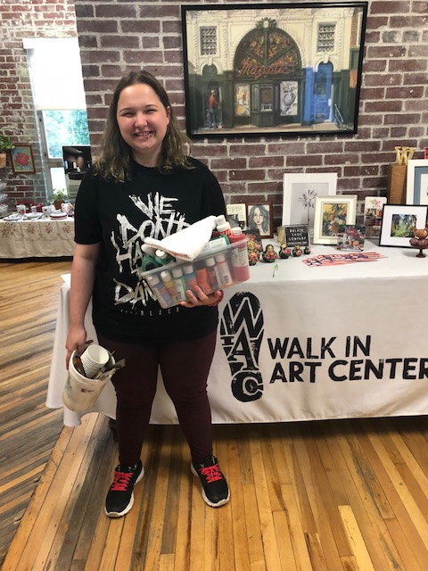
Success Stories
Left: Mckenna Morgan, 14, Pottsville HS, at Bakeshop IV with Brian Setlock
Center: Zaria Sementilli, 17, Pottsville HS, at Pottsville Library
Right: Erin Vandemeer, 16, Schuylkill Haven HS, at Walk in Art Center

Slide 15
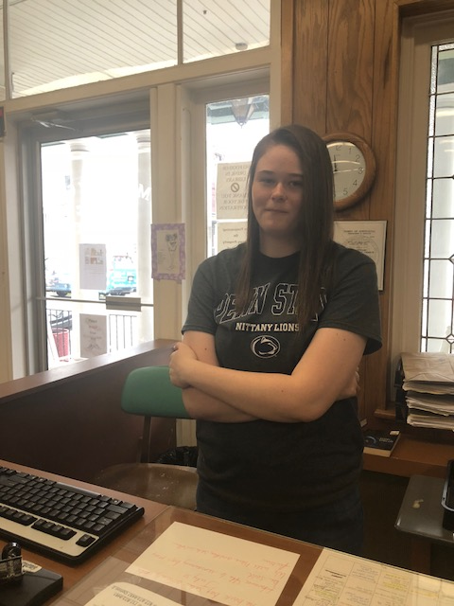
Success Stories…
Left: Kayla Howe, 17, Mahanoy City High School, Mahanoy City Boro Street Department
Right: Brook Leinheiser, , Mahanoy City High School, Mahahnoy City Library

